Slide 1
Chapter 22: Static electricity
Day 1
Explain course. Read syllabus. Answer questions.
Cover ppt slides 3-8.
Start on scotch tape in class exercise. Cover ppt slides 7-13.
Day 2
Cover ppt slides 13 – 25.
Give quiz C22 T1.
Developing a Feel, # 2 (ask students to solve)
Cover Guided problem 22.2

Slide 2
Chapter 22: Static electricity
Day 3
Demonstrate contents of slide 26.
Cover slides 26 - 28.
Demonstrate charging by induction
Give quiz C22 T2.
Finish in-class Worked Problem 22.4, 22.6.

Slide 3
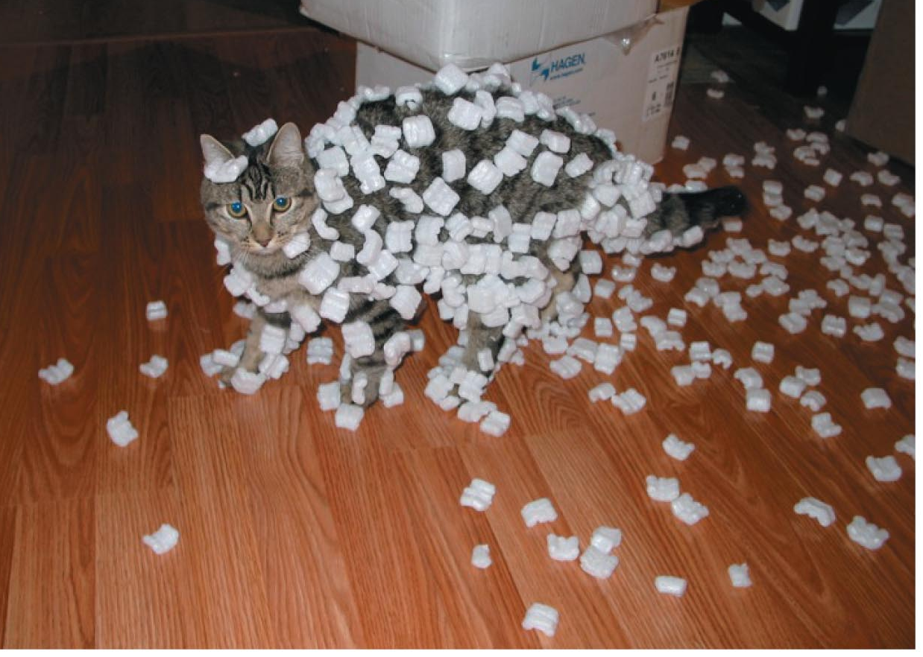
Section 22.1: Static electricity
Styrofoam peanuts are attracted to your arm when you unpack a box full of them. What causes these interactions?
I have made a huge mistake.

Slide 4
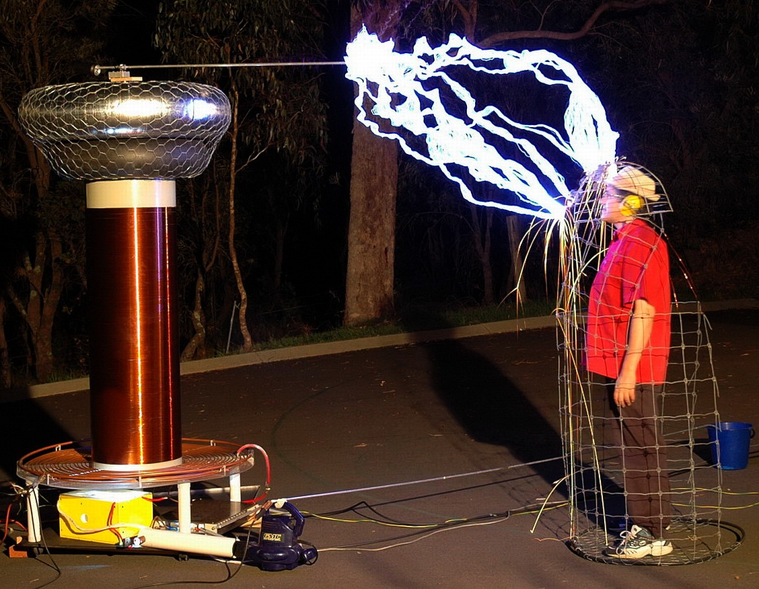
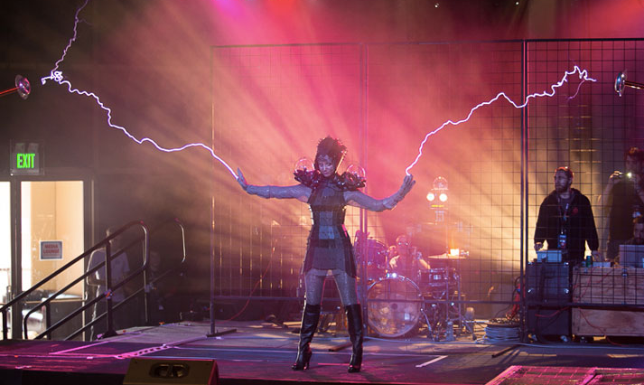
Section 22.1: Static electricity
http://www.ecouterre.com/faraday-cage-dress-lets-you-get-fashionably-zapped-by-lightning/

Slide 5
Concepts: Electric interactions
Chapter 22: Summary
An electric interaction is a long-range interaction between objects that carry a surplus electrical charge. The electric force is sometimes called the electrostatic force because interactions between charged objects become more complicated for objects that are not at rest (see Chapter 27).
There are only two types of charge: positive charge and negative charge. Objects that carry like charges repel each other; objects that carry opposite charges attract each other. Any microscopic object that carries electrical charge, such as an electron or ion, is called a charge carrier.

Slide 6
Concepts: Electric interactions
Chapter 22: Summary
The SI unit of charge is the coulomb (C), which is the magnitude of the charge carried by about 6.24 × 10¹⁸ electrons.
The elementary charge e is the smallest observed amount of charge and is equal to the magnitude of the charge carried by one electron:
e = 1.60 × 10^{–19} C.
The charge q carried by any object comes in whole-number multiples of e:
q = ne (n = 0, ±1, ±2, ±3, …).

Slide 7
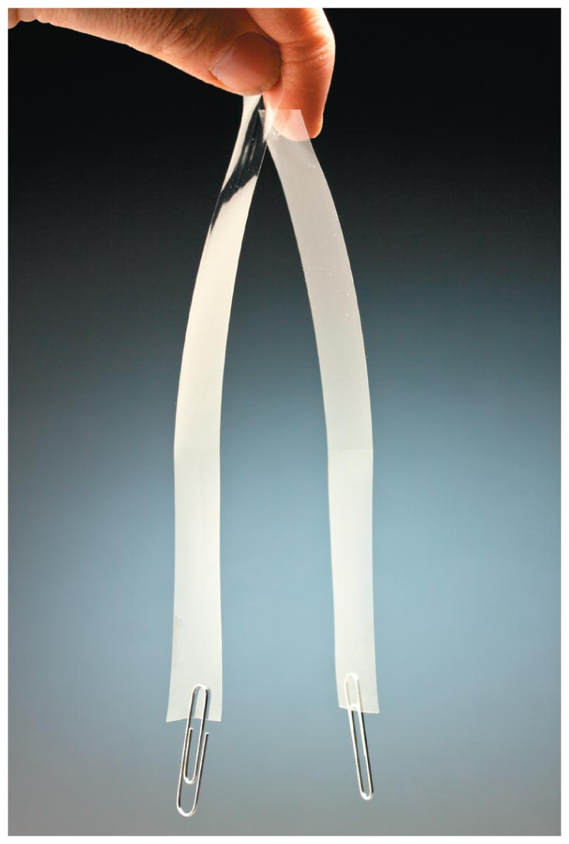
Checkpoint 22.2
Suspend a freshly prepared strip of transparent tape from the edge of your desk.
Prepare a second strip of tape and hold it near the first strip. What do you notice?
Does it matter which sides of the strips you orient toward each other?

Slide 8
Checkpoint 22.3
Suspend two freshly pulled 20-cm strips of transparent tape from the edge of your desk. Cut two 20-cm strips of paper, making each strip the same width as the tape, and investigate the interactions between the paper strips and the tape by bringing them near each other.
Which of the following combinations display an electric interaction: paper-paper, tape-paper, tape-tape?
 | P | T
P
T
Fill in the table.

Slide 9
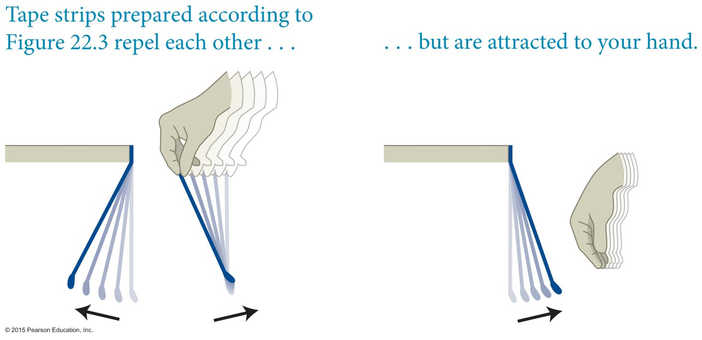
Section 22.2: Electrical charge
A suspended strip that was created according to the methods described in the previous slide interacts in ways that are illustrated in the figure.
The attribute responsible for the electric interaction is called electric charge, or simply charge.
Any macroscopic object that carries an electrical charge is called a charge carrier.

Slide 10
Checkpoint 22.4
(a) Prepare a charged strip of transparent tape as described in Figure 22.3 and then suspend the strip from the edge of your desk. Verify that the tape interacts as you would expect with your hand, with a strip of paper, and with another charged strip of tape. (b) Rub your fingers along the hanging strip to remove all the charge from it, and then verify that it no longer interacts with your hand. If it does interact, rub again until it no longer interacts. (c) Predict and then verify experimentally how the uncharged suspended strip interacts with a strip of paper and with a charged strip of tape.

Slide 11
Checkpoint 22.5
Recharge the discharged strip from Checkpoint 22.4 and verify that it interacts as before with your hand, with a strip of paper, and with another charged strip of tape.
22.5

Slide 12
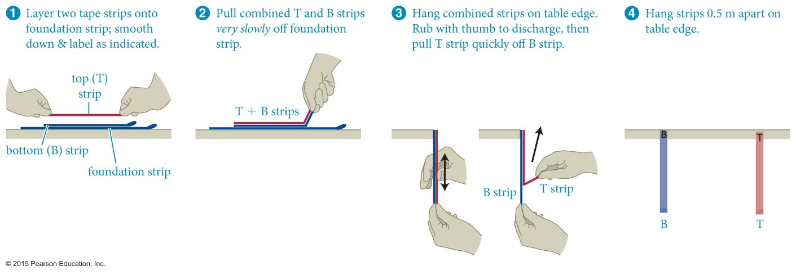
Checkpoint 22.7
Make two charged pairs of strips (B and T) following the procedure illustrated in Figure 22.5. Investigate the interaction of B with T, T with T, and B with B. Fill in the table.
22.7
Fill in the table.
 | B | T
B
T

Slide 13
Checkpoint 22.6
Follow the procedure illustrated in Figure 22.5 to separate a pair of charged strips. (a) How does strip B interact with a neutral object (paper)? How does strip T interact with a neutral object? (b) Create a third charged strip and see how it interacts with strip B and with strip T. (c) Is strip T charged? (d) Is strip B charged? (e) Check what happens to the interactions with B and T strips when you discharge a B or a T strip by rubbing your fingers along its length.
 | B | T | N
B
T
N
Fill in the table.

Slide 14
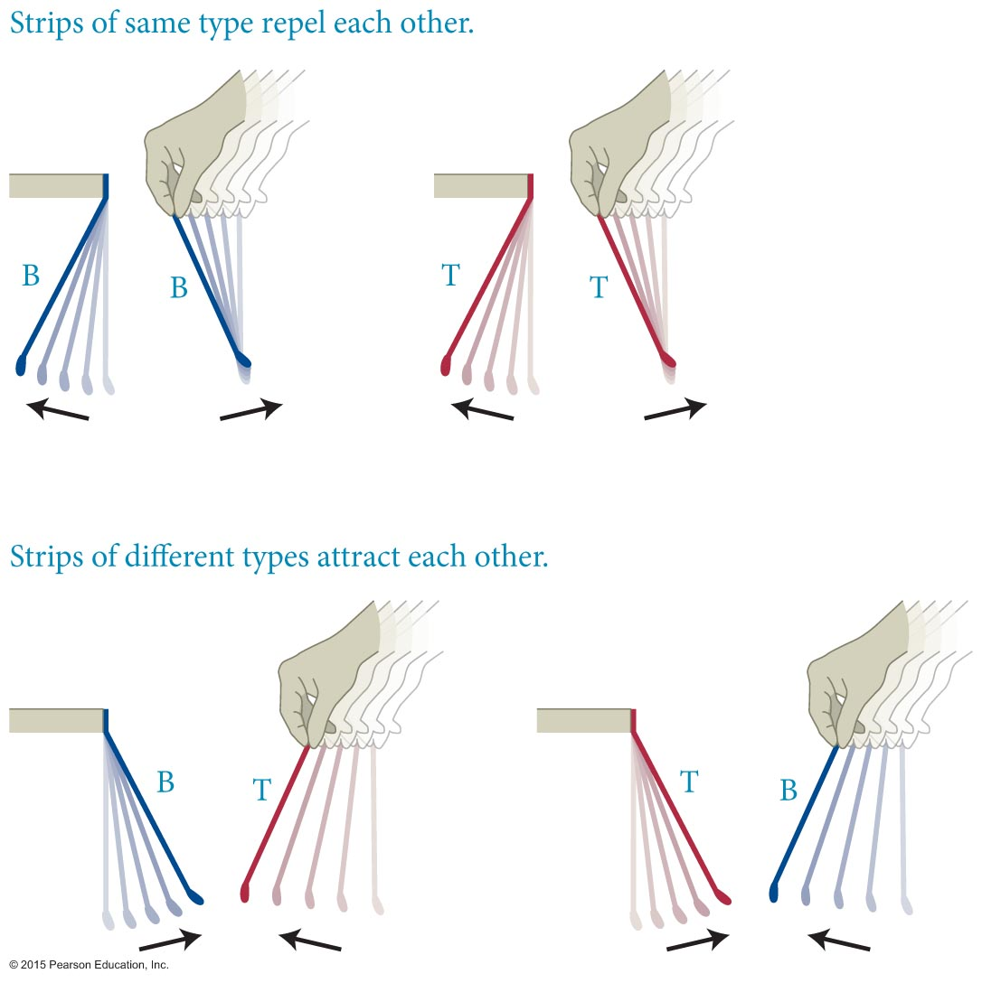
Section 22.2: Electrical charge
The interactions between tapes B and T are illustrated in the figure.
Conclusion: There are two and only two types of charge:
Objects that carry like charges repel each other.
Objects that carry opposite charges attract each other.

Slide 15
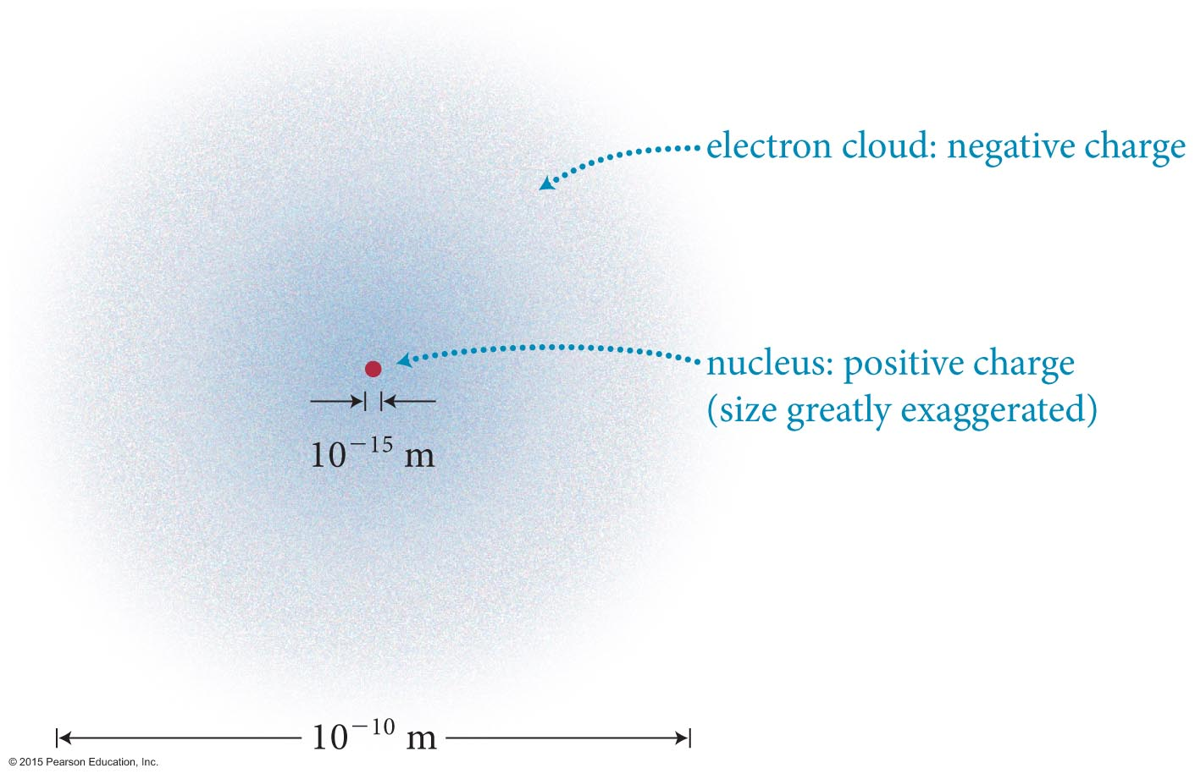
Section 22.3: Mobility of charge carriers
A schematic diagram of the atomic structure is shown in the figure.
Experiments show that
Electrons that surround the nucleus have a negative electrical charge.
All electrical charge comes in whole-number multiples of the electrical charge on the electron.
The magnitude of the charge on the electron is denoted by e, and is called the elementary charge.

Slide 16
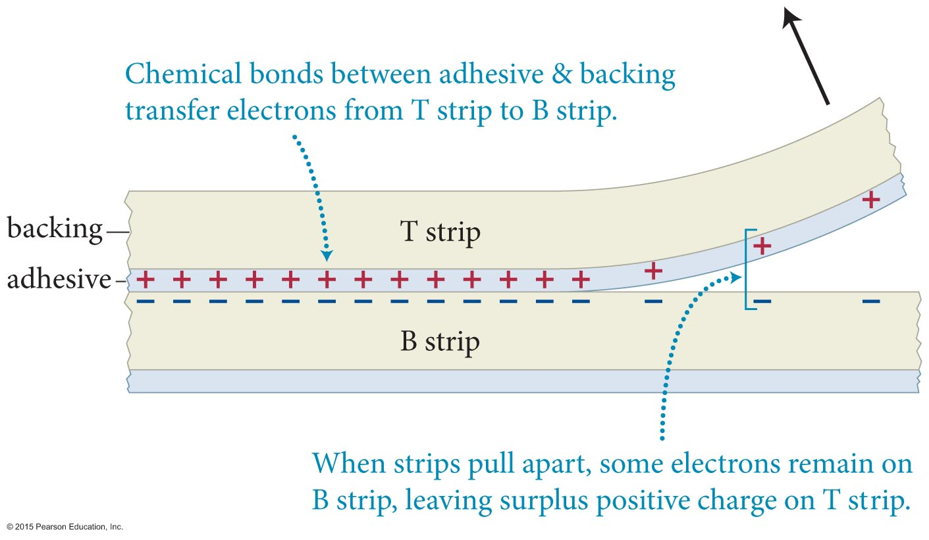
Section 22.3: Mobility of charge carriers
Any two dissimilar materials become charged when brought into contact with each other.
Adhesion means ionic bonds have formed with positive charges on one surface and negative on the other.
When they are separated rapidly, small amounts of opposite charge may be left behind on each material.
After the two strips are separated, the sum of the positive charge on strip T and negative charge on strip B is zero.
What happens if you separate two sticky surfaces?
Which gets charged which sign?
What if you tear a piece of paper, or break a piece of glass?
Which piece gets charged which sign?
Notes:
concept is that adhesion is a chemical bond in which there is charge transfer creating an ionic bond. One material has the positive charge and the other material has the negative charge. Quickly separating the surfaces breaks the bonds and leaves the opposite charges on the different materials.

Slide 17
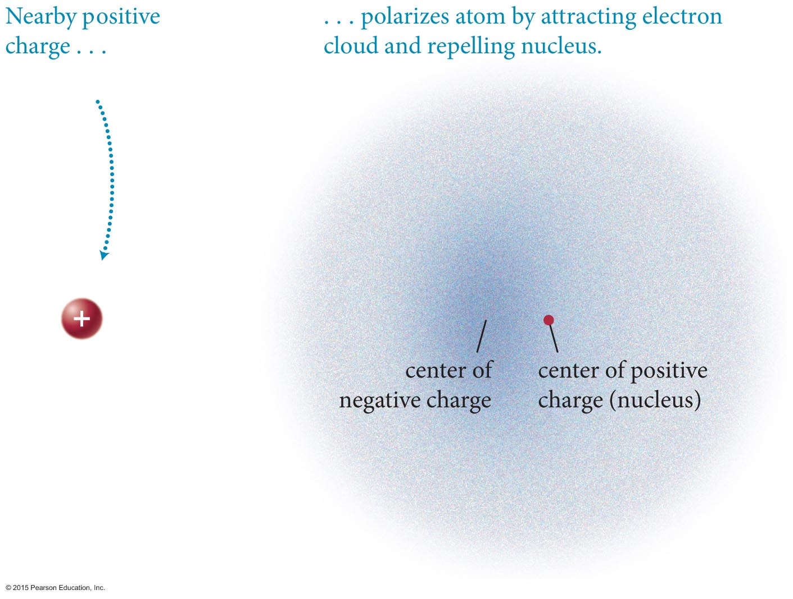
Section 22.4: Charge polarization
Insulators can be polarized even though the electrons are not free to move about.
The basic reason for the polarization of insulators is due to the polarization of the neutral atoms in the insulator.

Slide 18
Section 22.2
N
N
T
 | B | T | N
B
T
N
-
+
-
neutral
-
+
-
-
+
-
R repulse
A attract
X nothing
-
+
-
-
-
-
+
-
-
+
-
-
+
-
-
+
-
-
-
-
+
-
-
+
-
-
+
-
-
+
-
B
T
B
T
-
+
-
-
-
-
B
+
N
+
+
-
-
-
-
+
+
+
+
-
-
+
-
-
+
+
+
+
-
-
+
-
-
+
+
+
+
-
-
+
-
-
+
+
-
-
+
-
-
+
+
-
-
+
-
-
+
+
+
+
-
-
-
-
+
+
+
+
-
-
+
-
-
+
+
+
+
-
-
+
-
-
+
+
+
-
+
+
+
-
-
+
-
-
+
+
+
-
-
-
-
+
+
+
+
-
-
+
-
-
+
+
+
+
-
-
+
-
-
+
+
+
+
-
-
+
-
-
+
+
Notes:
concept is that adhesion is a chemical bond in which there is charge transfer creating an ionic bond. One material has the positive charge and the other material has the negative charge. Quickly separating the surfaces breaks the bonds and leaves the opposite charges on the different materials.

Slide 19
Section 22.2
N
N
T
 | B | T | N
B | R | A | A
T | A | R | A
N | A | A | X
-
+
-
neutral
-
+
-
-
+
-
R repulse
A attract
X nothing
-
+
-
-
-
-
+
-
-
+
-
-
+
-
-
+
-
-
-
-
+
-
-
+
-
-
+
-
-
+
-
B
T
B
T
-
+
-
-
-
-
B
+
N
+
+
-
-
-
-
+
+
+
+
-
-
+
-
-
+
+
+
+
-
-
+
-
-
+
+
+
+
-
-
+
-
-
+
+
-
-
+
-
-
+
+
-
-
+
-
-
+
+
+
+
-
-
-
-
+
+
+
+
-
-
+
-
-
+
+
+
+
-
-
+
-
-
+
+
+
-
+
+
+
-
-
+
-
-
+
+
+
-
-
-
-
+
+
+
+
-
-
+
-
-
+
+
+
+
-
-
+
-
-
+
+
+
+
-
-
+
-
-
+
+
Notes:
concept is that adhesion is a chemical bond in which there is charge transfer creating an ionic bond. One material has the positive charge and the other material has the negative charge. Quickly separating the surfaces breaks the bonds and leaves the opposite charges on the different materials.

Slide 20
Quantitative Tools: Electric interactions
Chapter 22: Summary
Coulomb’s law states that if particle 1 carrying charge q₁ and particle 2 carrying charge q₂ are a distance r₁₂ apart, the electric force exerted by particle 1 on particle 2 is
where the unit vector points from particle 1 to particle 2 and the constant k is

Slide 21
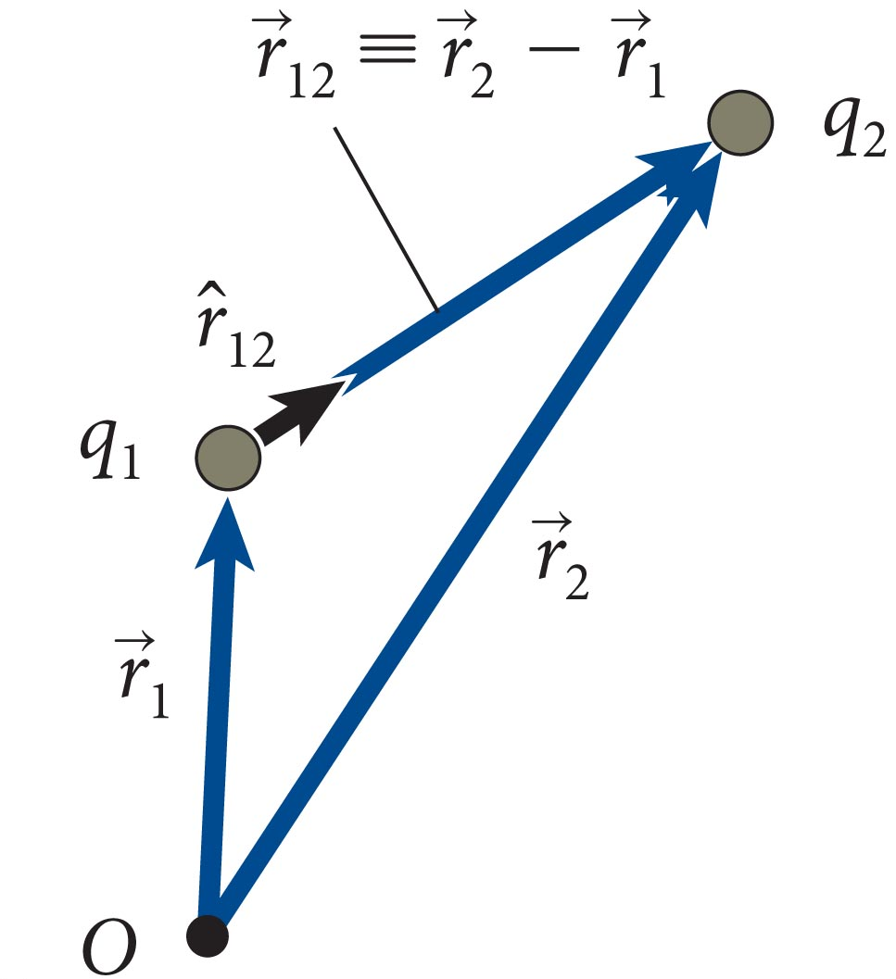
Section 22.5: Coulomb’s law
Consider the two particles carrying charges q₁ and q₂, as shown in the figure.
As illustrated in the figure, we can define a unit vector pointing from particle 1 to particle 2 as
Notes:
ask class if they can calculate the angle at which the unit vector is pointing if the charges are located at (4,5) and (7,8).

Slide 22
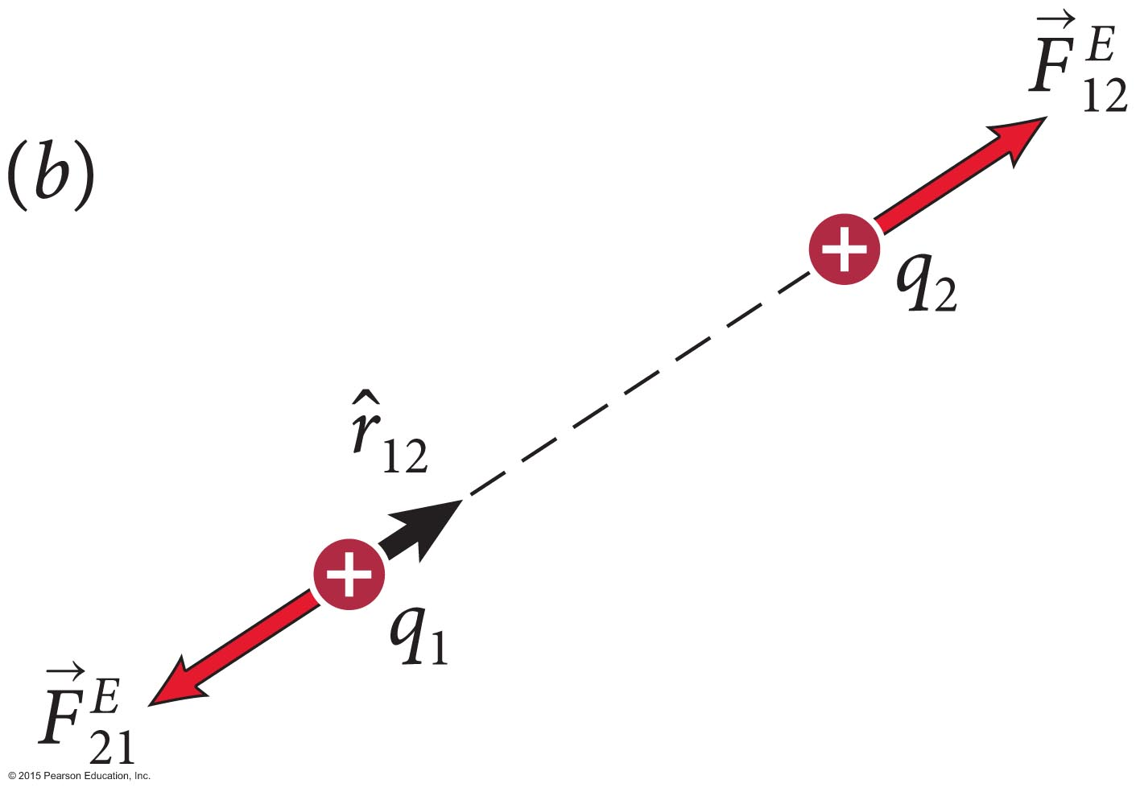
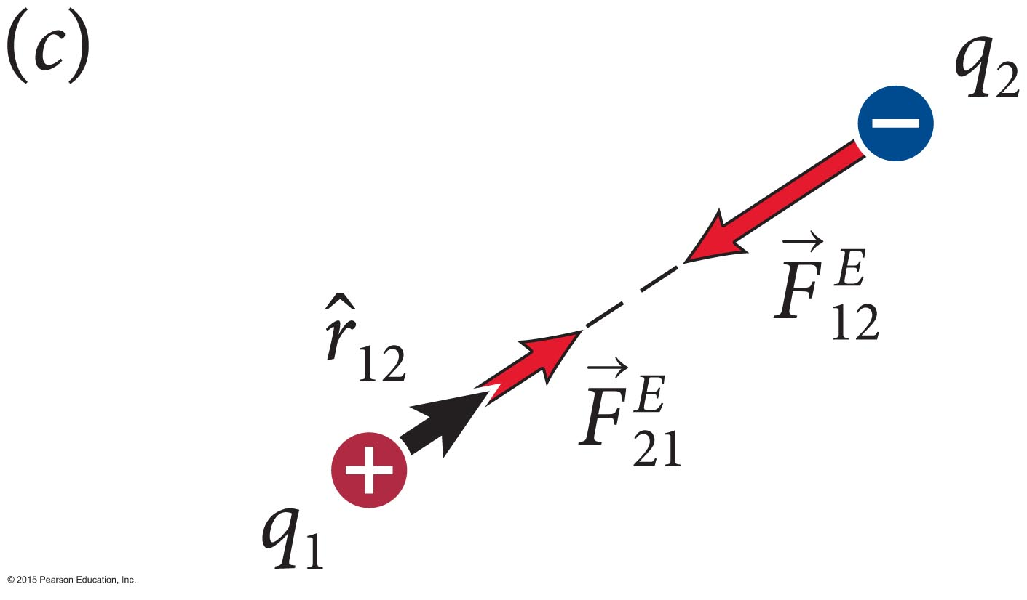
Section 22.5: Coulomb’s law
Depending on the algebraic sign of the charges, the electric force can be attractive or negative.
The force exerted by particle 1 on particle 2 is
The force exerted by particle 2 or particle 1 is thus

Slide 23
Section 22.6: Force exerted by distributions of charge carriers
The force exerted by an assembly of objects carrying charges q₂, q₃, . . . on an object 1 carrying charge q₁ is
Each term in the previous equation is given by Coulomb’s law:

Slide 24
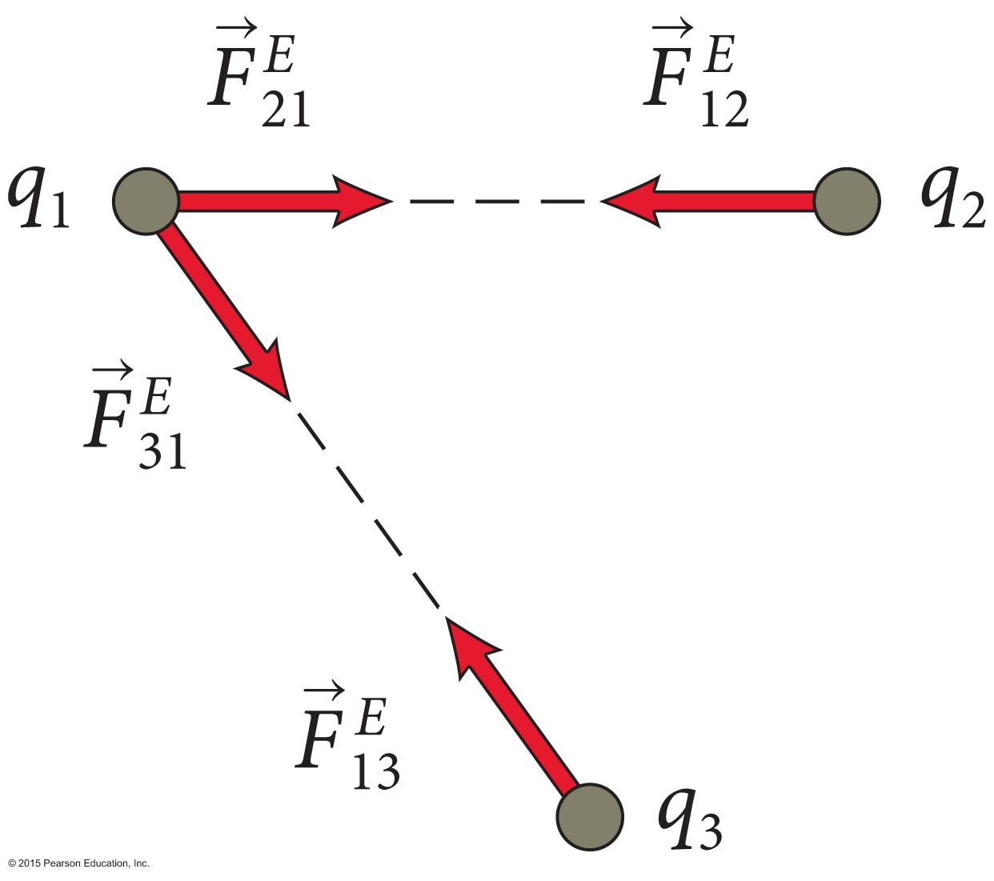
Checkpoint 22.19
Figure 22.29 shows how a charged particle 1 interacts with two other charged particles 2 and 3. Determine the direction of the vector sum of the electric forces exerted on particle 2.
22.19

Slide 25
Checkpoint 22.19
Figure 22.29 shows how a charged particle 1 interacts with two other charged particles 2 and 3. Determine the direction of the vector sum of the electric forces exerted on particle 2.
22.19
opposites
like
opposites

Slide 26
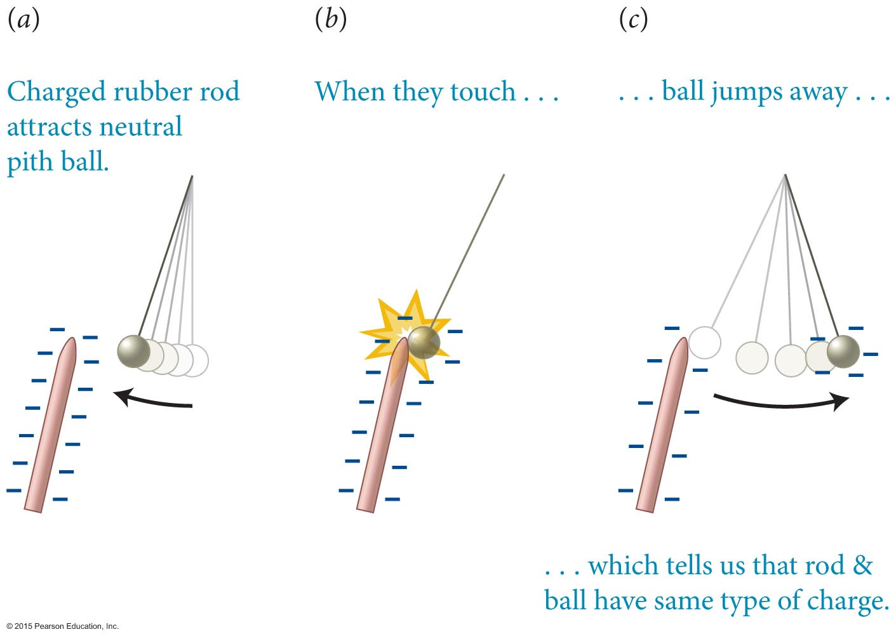
Section 22.3: Mobility of charge carriers
Charge can be transferred from one object to another by bringing the two into contact.

Slide 27
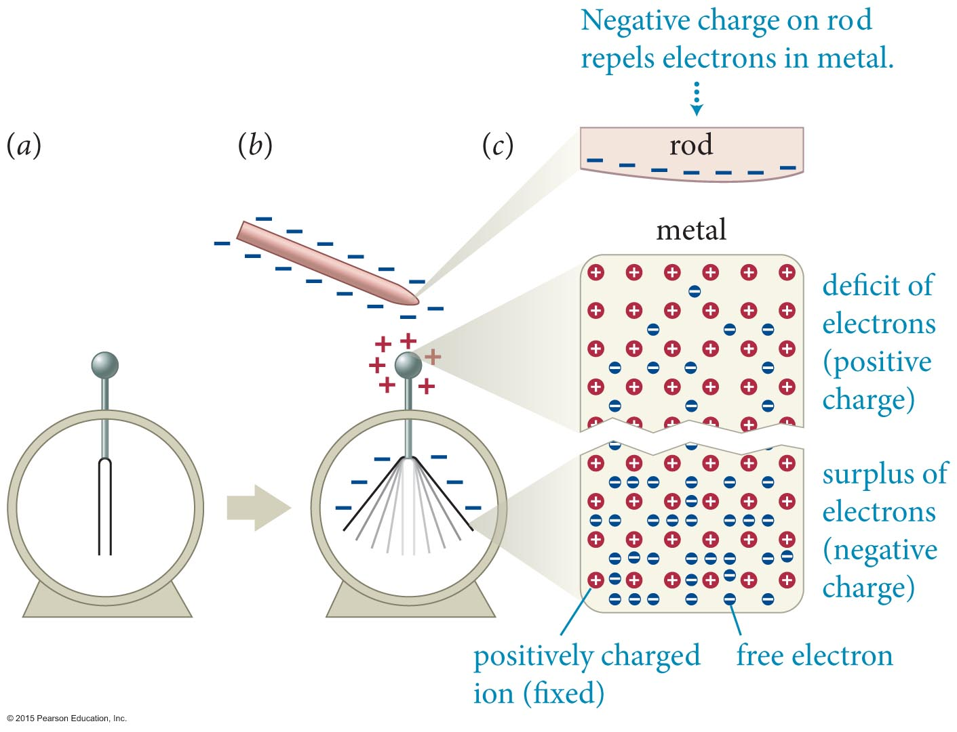
Section 22.4: Charge polarization
The figure shows the interaction between a charged rubber rod and an uncharged electroscope.
The negative charge on the rod repels the free electrons on the conducting parts of the electroscope, causing a separation of charge.
Any separation of charge carriers in an object is called charge polarization, or simply polarization.

Slide 28
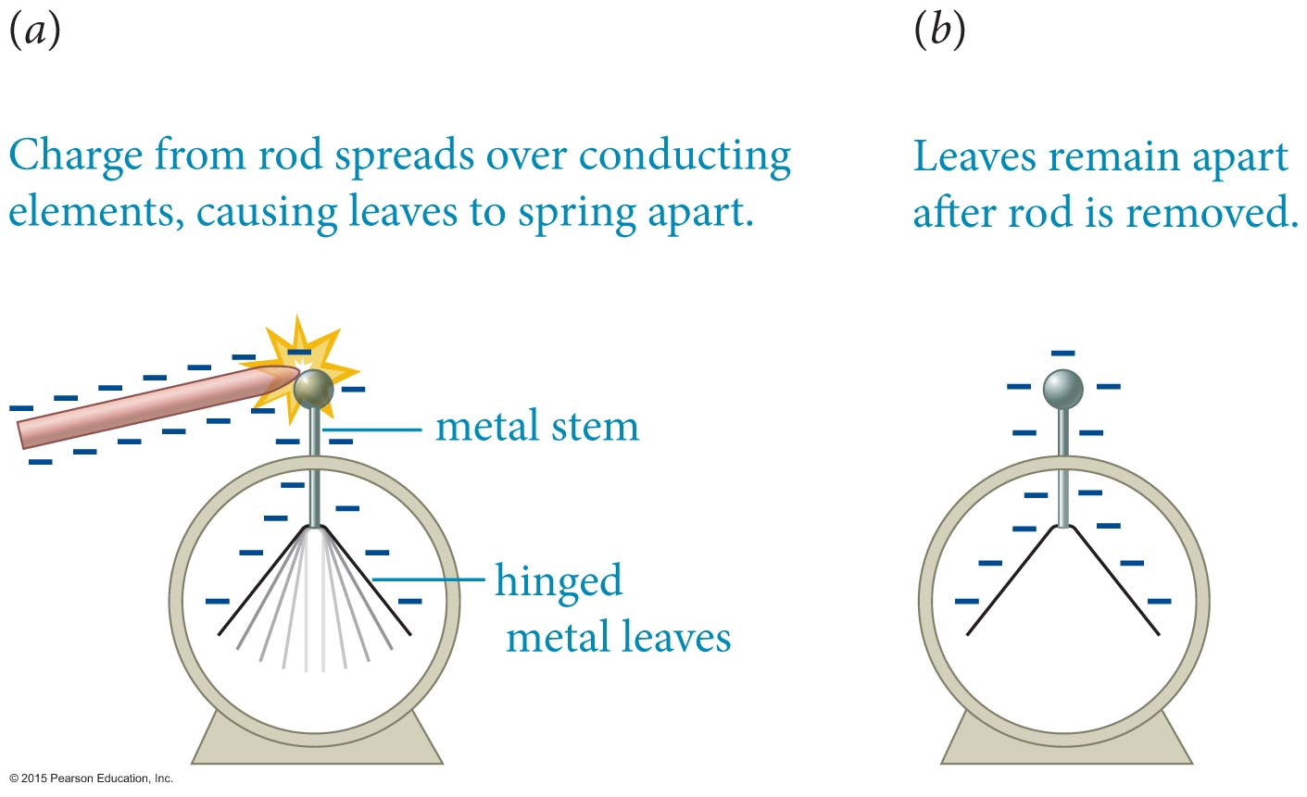
Section 22.3: Mobility of charge carriers
Materials through which charge carriers can flow are called electrical conductors.
The flow of charge through conductors is called conduction.

